Slide 1
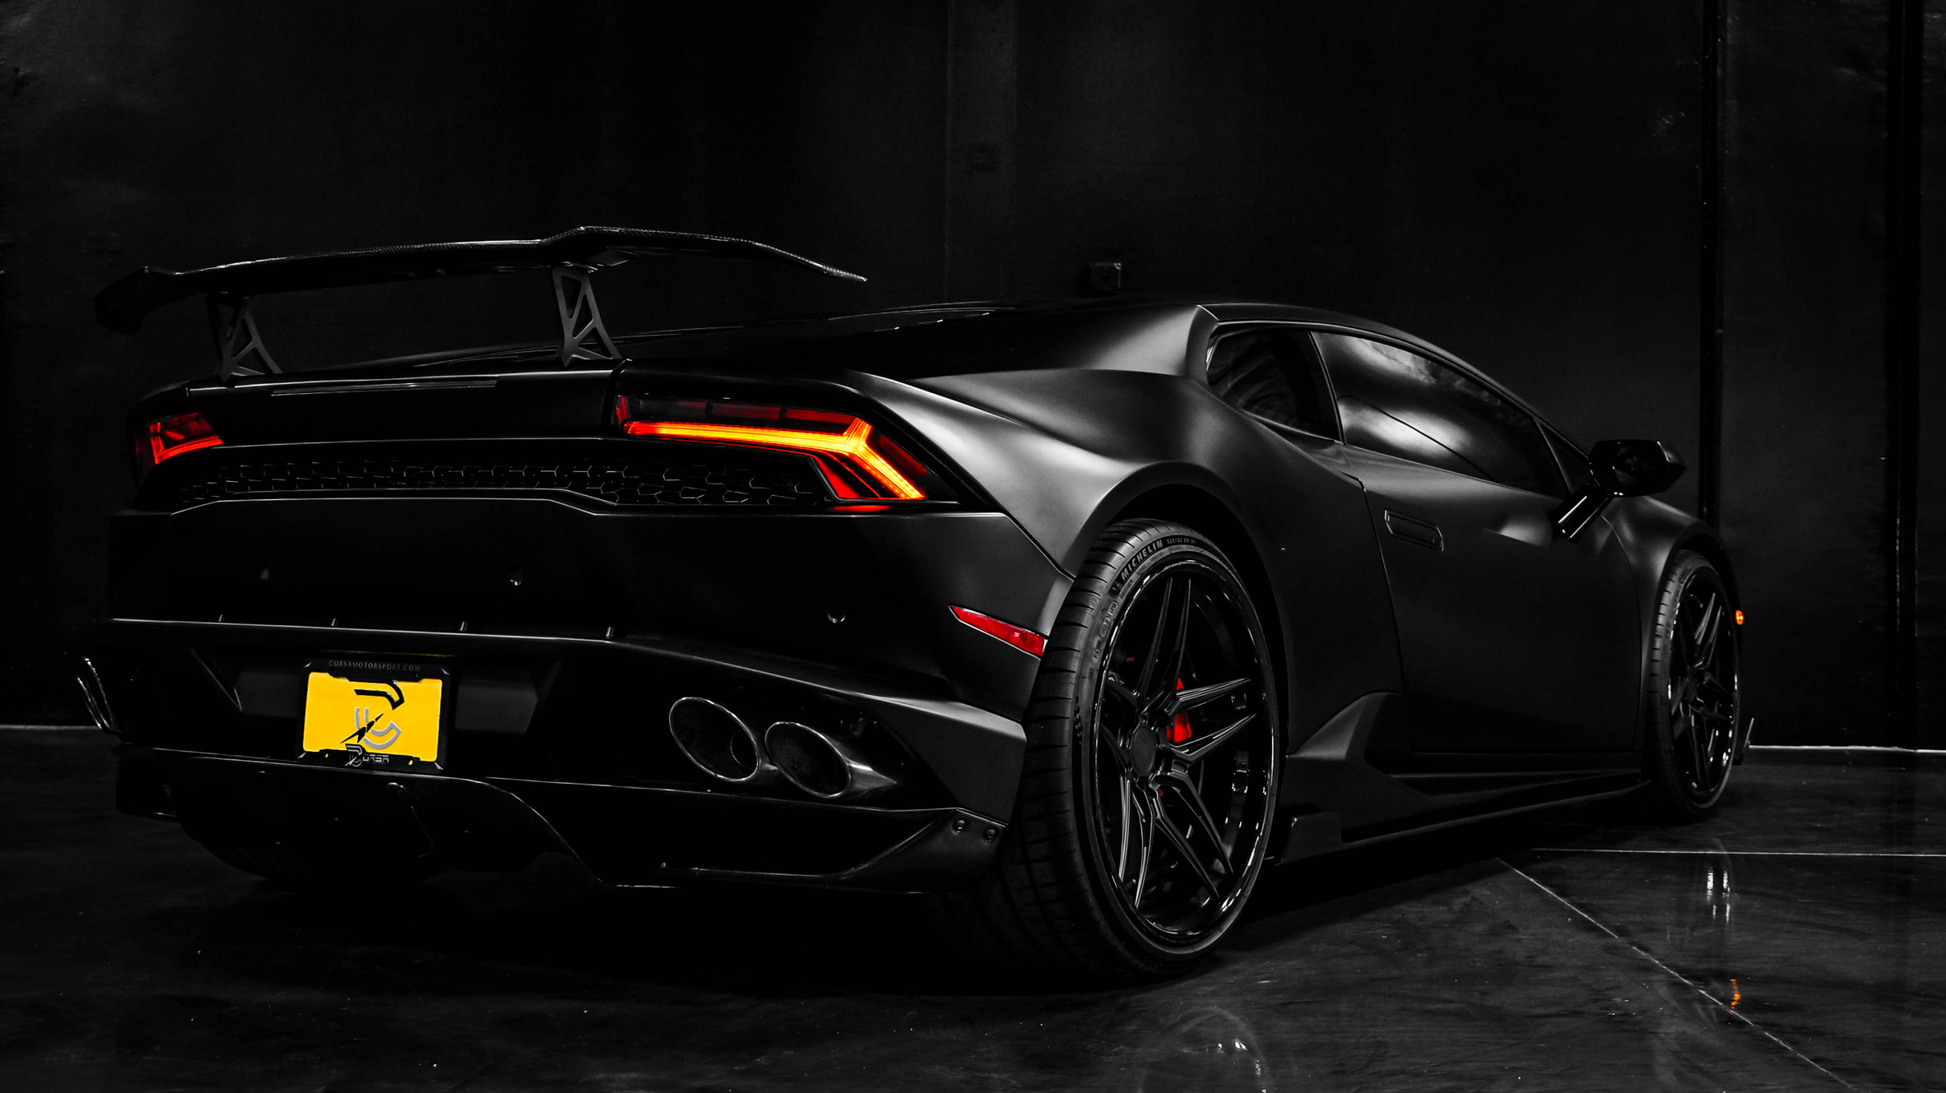


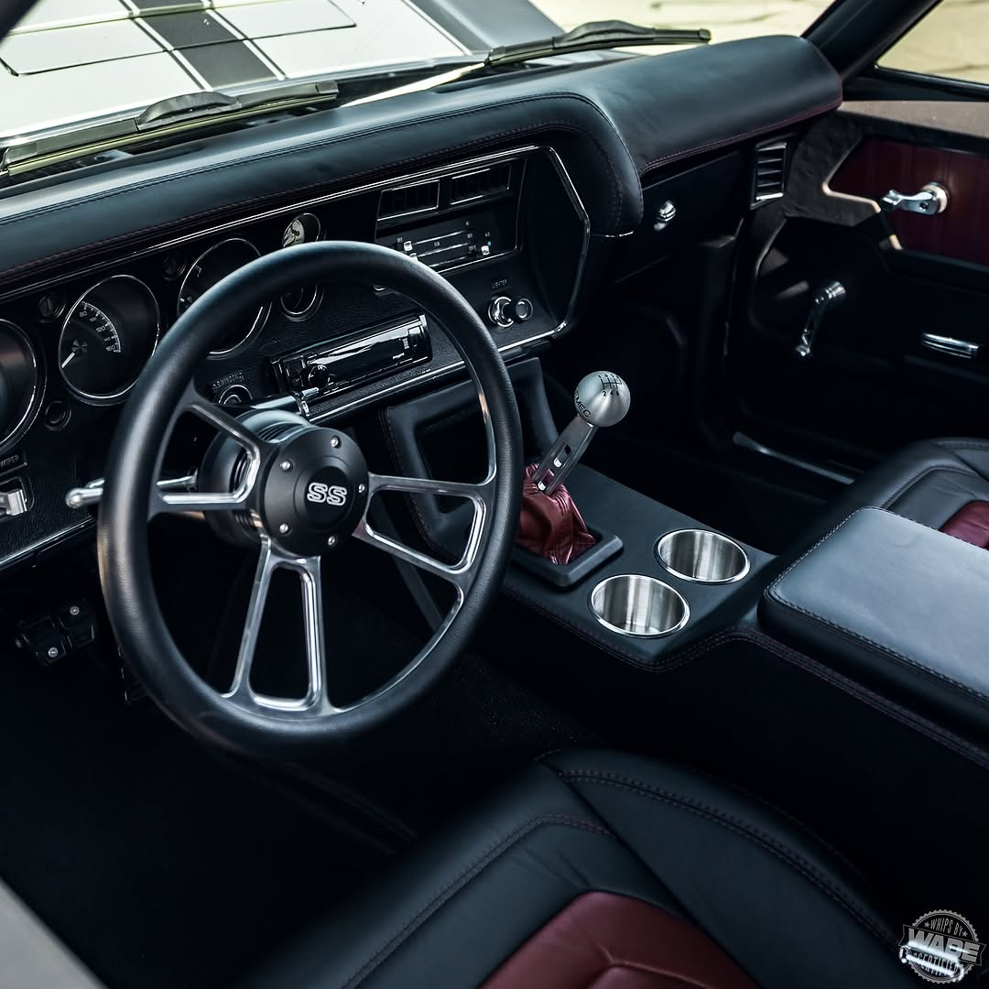

MOTOR CONNECT
Experience the future of mobility with Motor Connect
We're leading the way with innovative, sustainable solutions that seamlessly connect you to personalized mobility options. Our commitment to trust, innovation, and exceptional service ensures an unparalleled driving experience."
2025 Presentation

Slide 2
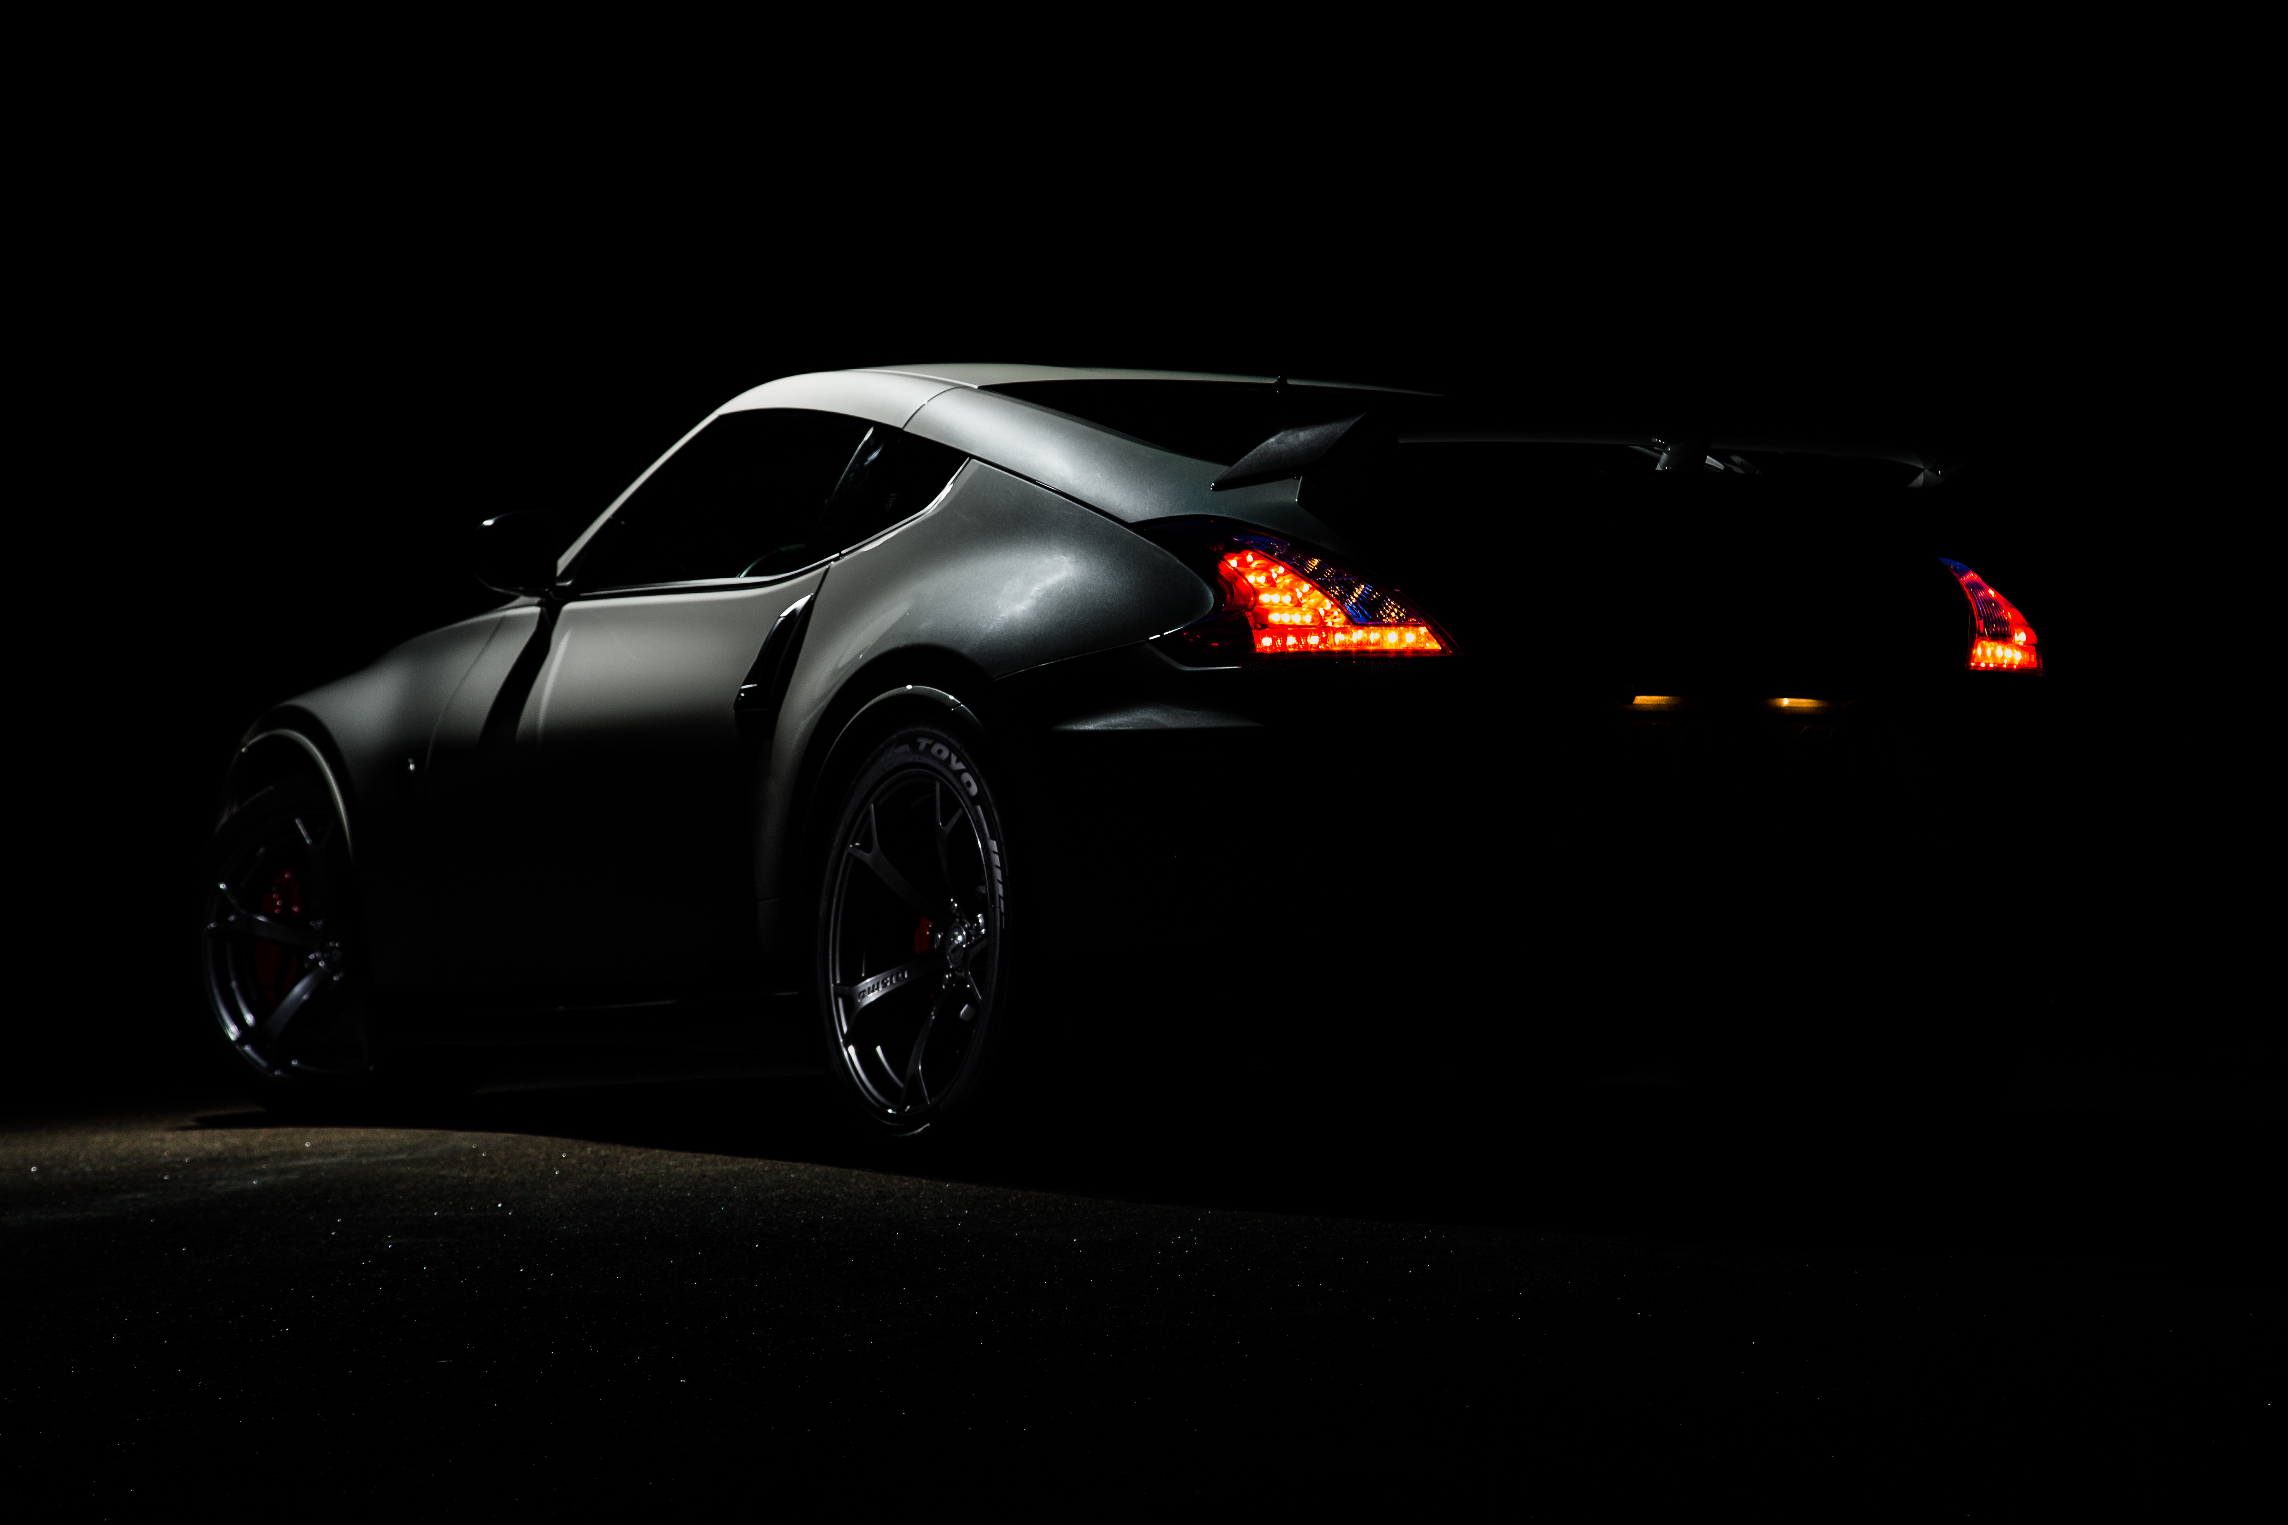
MOTOR CONNECT
"We believe that driving should be an experience. We're more than just a dealership – we're your partner in effortless mobility. We seamlessly connect individuals and businesses alike to personalized solutions, exceeding expectations with trust, innovation, and exceptional service."
2025 Presentation

Slide 3
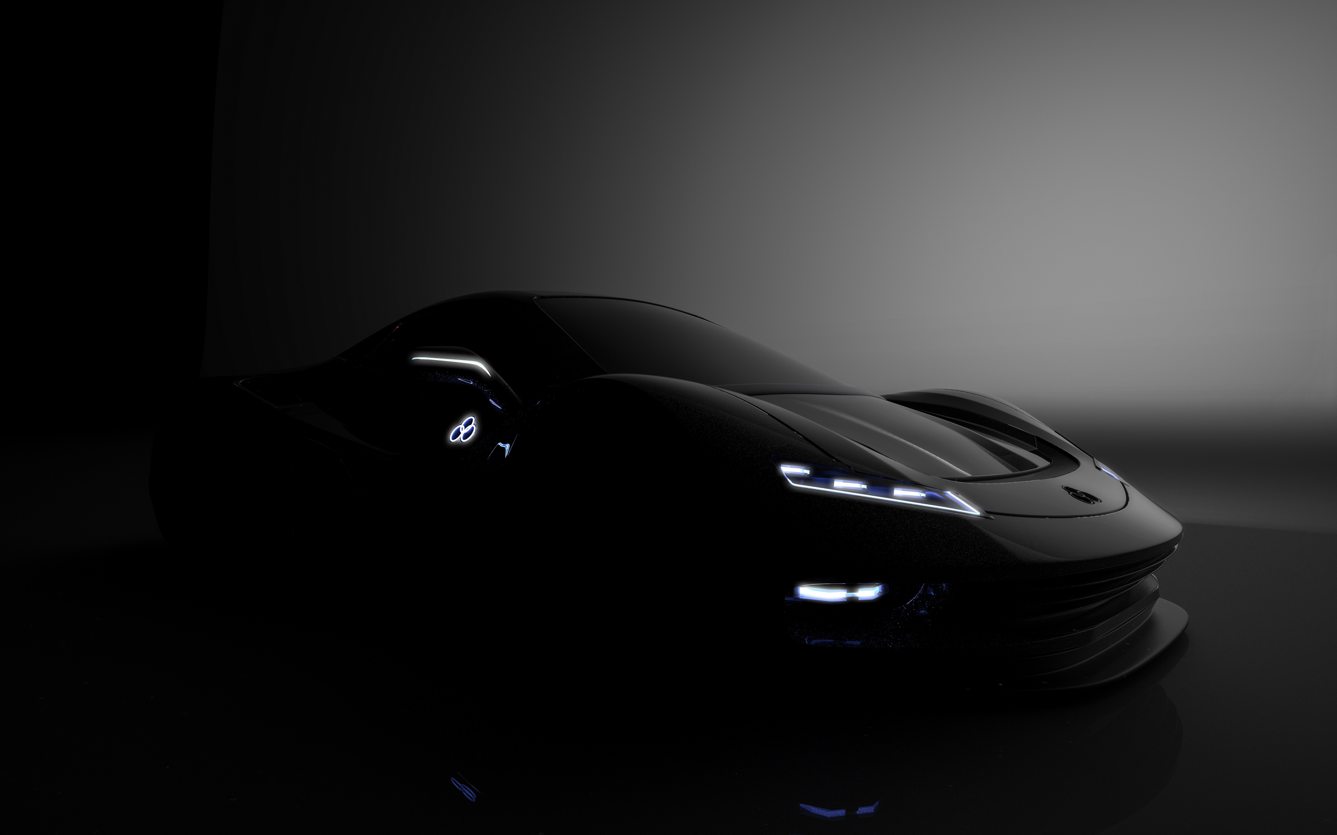
MOTOR CONNECT
ABOUT US
We’re committed to providing a seamless and personalized experience for every client. Whether you’re looking to own your dream car, rent a vehicle for a special occasion, explore tailored financing and insurance options, or secure reliable truck supply for your business needs, our expert team is here to guide you every step of the way.
Driven by innovation and customer satisfaction, Motor Connect is more than just a dealership—we’re a connection to the road ahead.
At Motor Connect, we make your journey seamless. From buying your dream car to renting, chauffeuring, financing, and insurance, we’re your trusted partner for all things automotive. Experience excellence, tailored for you.

Slide 4

MOTOR CONNECT
VISION
"Transforming mobility with innovative, seamless, and sustainable solutions that empower individuals and businesses, enhancing the driving experience for all."
We envision to be the Leading automotive lifestyle partner, seamlessly connecting individuals to personalized mobility solutions
2025 Presentation

Slide 5
MOTOR CONNECT
MISSION
We are dedicated to:
Delivering cutting-edge mobility solutions through technology and personalized service.
Simplifying access to vehicle sales, rentals, chauffeuring, financing, and insurance.
Promoting sustainability and affordability to create lasting value for our customers and communities.
Ensuring trust, reliability, and excellence in every customer interaction.
2025 Presentation

Slide 6
MOTOR CONNECT
Values
Customer-Centric Approach
Innovation and Excellence
Sustainability and Responsibility
Integrity and Trust
Affordability and Accessibility
Collaboration and Teamwork
Commitment to Quality
Empowerment through Mobility
2025 Presentation

Slide 7
MOTOR CONNECT
OUR HISTORY
For over 5 years, Motor Connect has been connecting South Africans with the vehicles of their dreams. Our commitment to customer satisfaction and unwavering integrity has built a legacy of trust that continues to drive us forward.
2022
2023
2024
One of the most impactful years of our existence, we became more than just a dealership – we stamped our foot on building lasting relationships with our customers.
From our humble beginnings to becoming a leading automotive partner, Motor Connect has grown alongside South Africa. We celebrate years of providing exceptional service and look forward to many more years of connecting people with their perfect vehicles
We have been at the forefront of the automotive industry, embracing innovation and adapting to the evolving needs of our customers. We're proud of our history and excited for the future of mobility.

Slide 8
OUR BEST SERVICE
MOTOR CONNECT
VEHICLE SALES
High-end and middle-class vehicles tailored to suit your lifestyle
INSURANCE SERVICES
Comprehensive insurance cover at the best suitable prices
CAR HIRE & CHAUFFEURING SERVICES
Flexible rental options for every occasion & Luxury travel with professional drivers
FINANCING SOLUTIONS
2025 Presentation
Tailored plans to make car ownership easier

Slide 9
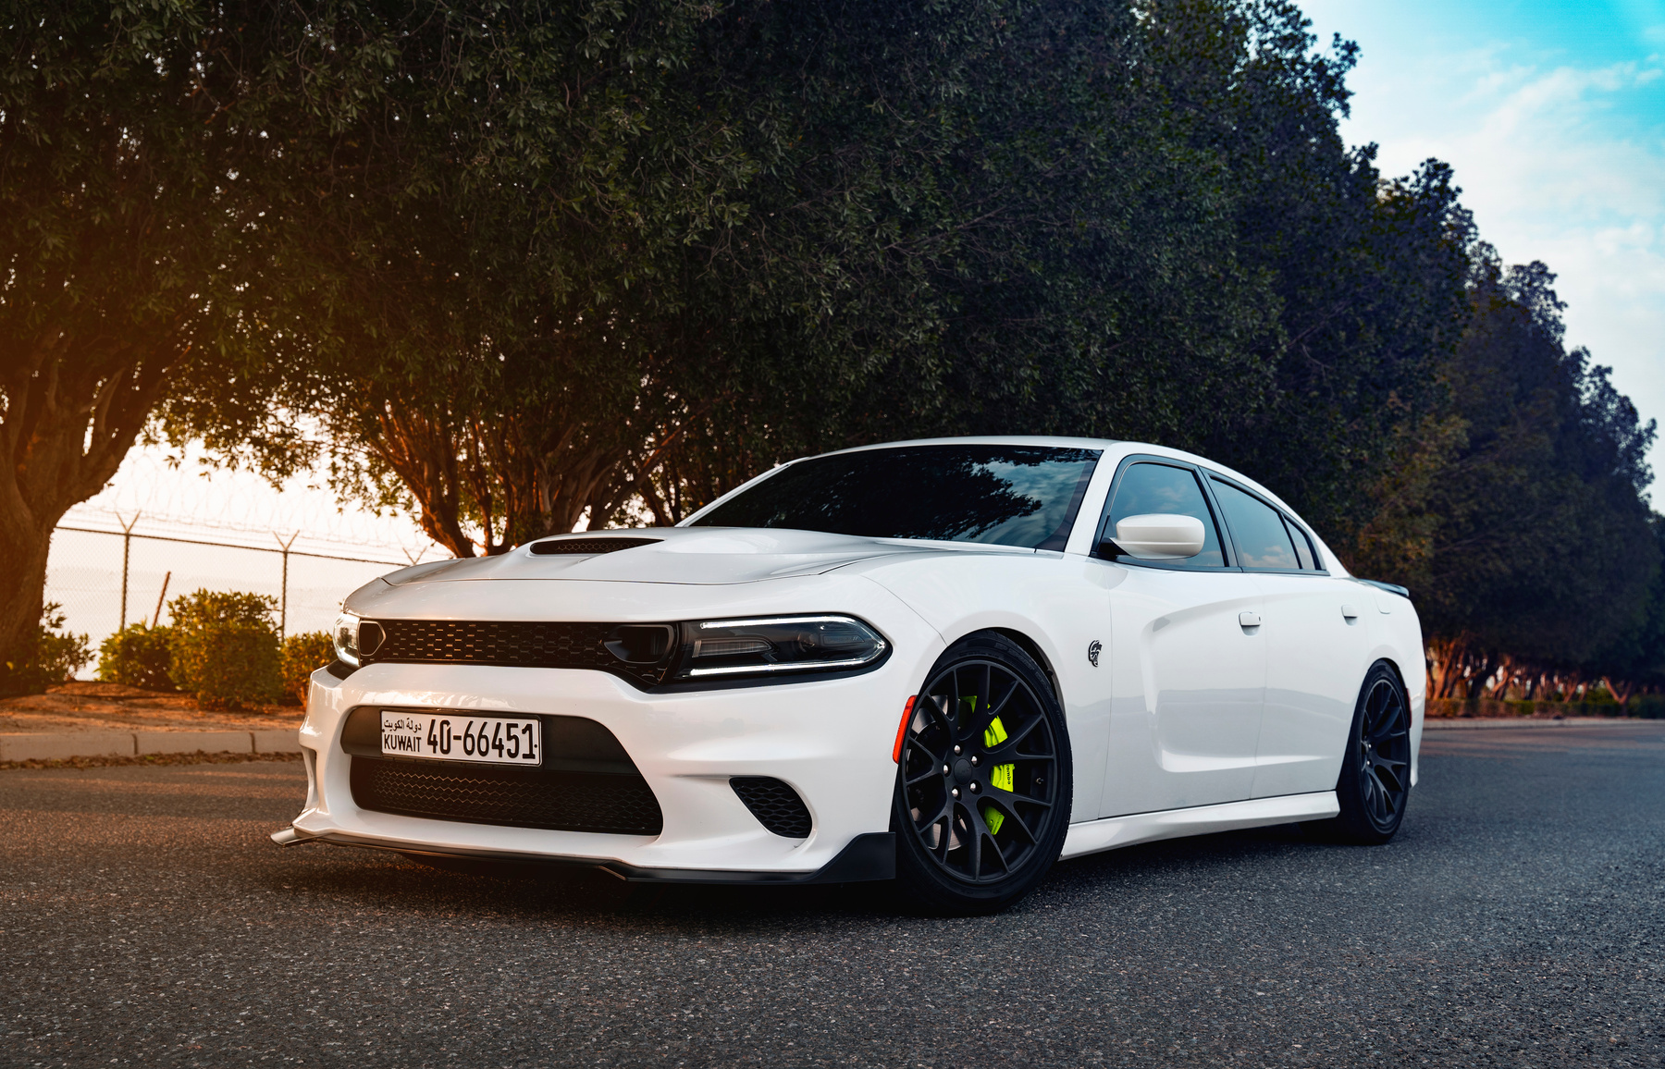
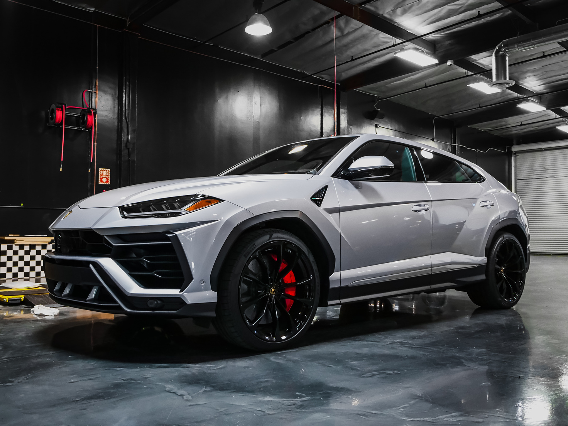
MOTOR CONNECT
LATEST PORTFOLIO
Explore our extensive fleet of new cars, featuring the latest models from top brands. Whether you're seeking a sleek sedan, a rugged SUV, or a fuel-efficient hybrid, we have the perfect vehicle to match your lifestyle.
2025 Presentation

Slide 10
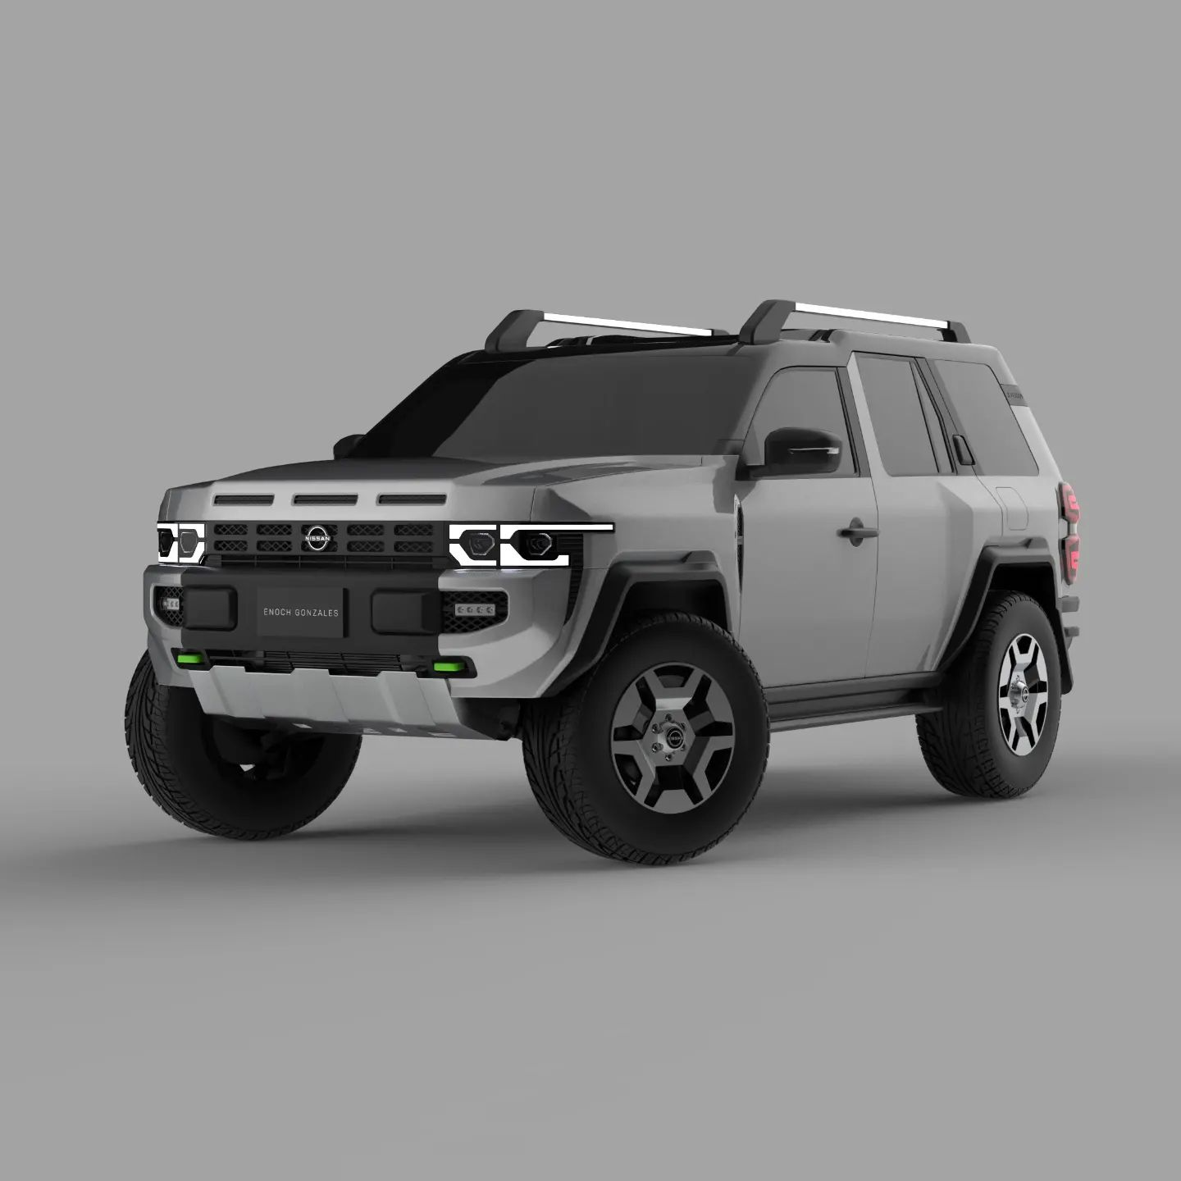
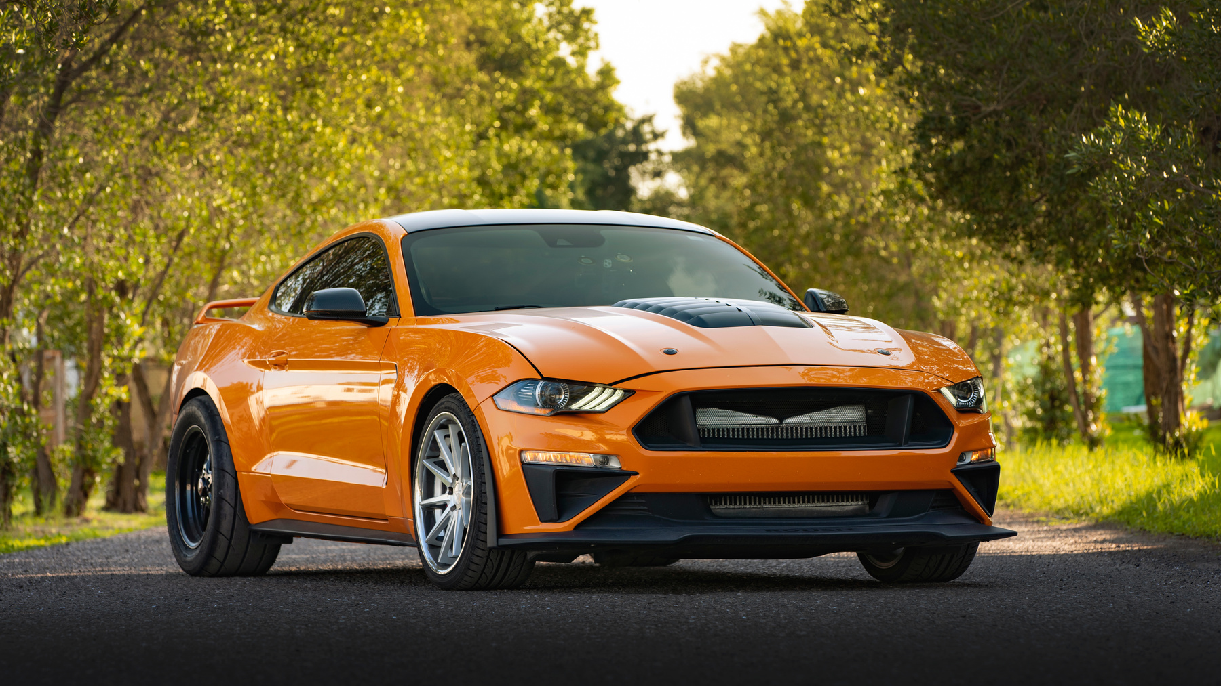
MOTOR CONNECT
LATEST PORTFOLIO
Explore our extensive fleet of new cars, featuring the latest models from top brands. Whether you're seeking a sleek sedan, a rugged SUV, or a fuel-efficient hybrid, we have the perfect vehicle to match your lifestyle.
2025 Presentation

Slide 11




GET IN TOUCH
Ready to explore the world of effortless mobility?
Whether you're interested in purchasing a new or pre-owned vehicle, exploring our rental options, inquiring about chauffeur services, or seeking expert advice on financing and insurance, our team is here to guide you.
Contact us today and experience the Motor Connect difference.
Phone Number
Email
+27 72 190 5700
info@motorconnect.co.za
Website
Social Media
www.motorconnect.co.za
@motorconnectza

Slide 12

MOTOR CONNECT
THANK YOU
Explore our latest offers and join the Motor Connect family.

